Slide 1
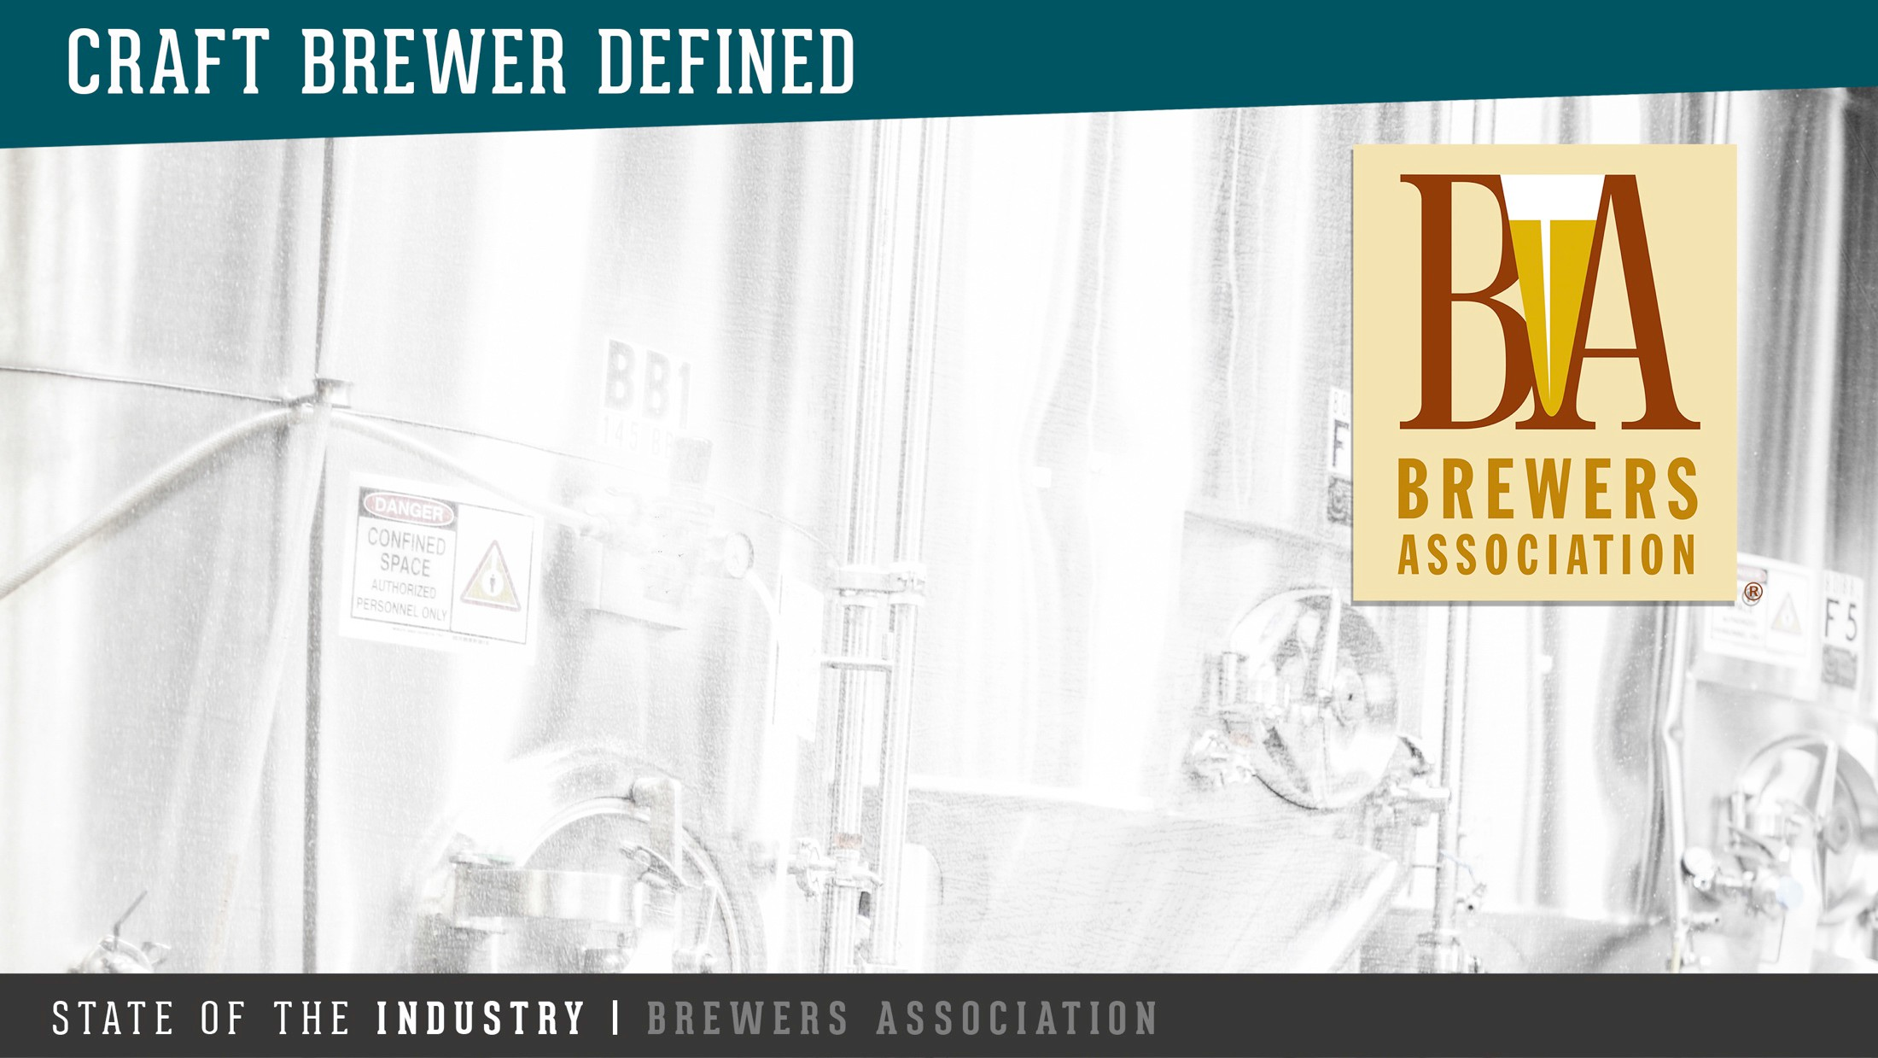
Analysis of
Craft Beers
Analyzing producers, alcoholic content, bitterness, and other data of the industry
-- Cl)
Chaoshun Hu
Mahesh Kuklani
Rene M. Pineda

Slide 2
Introduction
The craft beer Market in the U.S.
There is a surge in popularity of craft beers in the United States. According to the Brewers Association, the overall beer market size in the U.S. was USD 111.4 Billion in 2017, of which USD 26 Billion belong to "craft beers". Retail dollar sales of craft increased 8%, a much larger growth than the rest of the industry.
In volume terms, Overall U.S. beer volume sales were down 1% in 2017, whereas craft brewer sales continued to grow at a rate of 5% by volume, reaching 12.7% of the U.S. beer market by volume.
Craft Breweries
The characteristics of American craft beer producers are: small, independent, and traditional.
There has been an explosive growth of craft breweries, the total number of breweries rose from 42 in 1978 to over 2,750 in 2012.
The primary objective of this work is to provide the Brewers Association with insights that can help to understand the craft beers industry, using sample data from producers in the United States.
Presented to the Brewers Association | Boulder, CO

Slide 3
Description of the Data
Beers Data Set:
2,410 different craft beers
Variables:
Name: Name of the Beer
Beer_ID: ID number for each beer
ABV: Alcohol by volume
ABU: International Bitterness Unit
Brewery_id: ID number for each brewery
Style: Style of Beer
Ounces: Fluid ounces of each beer
Breweries data set:
558 craft beer producers
Variables:
Brew_ID: ID number for each brewery
Name: Brewery Name
City: City each brewery is located
State: State each brewery is located
We merged the data set by the ID of the brewery.
Presented to the Brewers Association | Boulder, CO

Slide 4
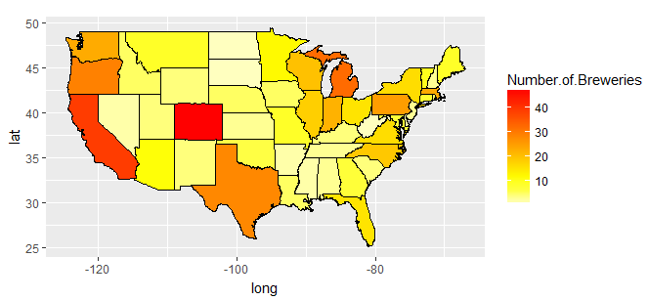
Which States have the largest number of breweries?
Presented to the Brewers Association | Boulder, CO

Slide 5
First and last observations of the merged data set
First 6 Observations
 | Brewery_ID | Beer_Name | Beer_ID | ABV | IBU | Style | Ounces | Brewery_Name | City | State
1 | 1 | Parapet ESB | 2687 | 0.056 | 47 | Extra Special / Strong Bitter (ESB) | 16 | NorthGate Brewing | Minneapolis | MN
2 | 1 | Stronghold | 2688 | 0.06 | 25 | American Porter | 16 | NorthGate Brewing | Minneapolis | MN
3 | 1 | Pumpion | 2689 | 0.06 | 38 | Pumpkin Ale | 16 | NorthGate Brewing | Minneapolis | MN
4 | 1 | Wall's End | 2690 | 0.048 | 19 | English Brown Ale | 16 | NorthGate Brewing | Minneapolis | MN
5 | 1 | Maggie's Leap | 2691 | 0.049 | 26 | Milk / Sweet Stout | 16 | NorthGate Brewing | Minneapolis | MN
6 | 1 | Get Together | 2692 | 0.045 | 50 | American IPA | 16 | NorthGate Brewing | Minneapolis | MN
Last 6 Observations
 | Brewery_ID | Beer_Name | Beer_ID | ABV | IBU | Style | Ounces | Brewery_Name | City | State
2405 | 556 | Pilsner Ukiah | 98 | 0.055 | NA | German Pilsener | 12 | Ukiah Brewing Company | Ukiah | CA
2406 | 557 | Porkslap Pale Ale | 49 | 0.043 | NA | American Pale Ale (APA) | 12 | Butternuts Beer and Ale | Garrattsville | NY
2407 | 557 | Moo Thunder Stout | 50 | 0.049 | NA | Milk / Sweet Stout | 12 | Butternuts Beer and Ale | Garrattsville | NY
2408 | 557 | Snapperhead IPA | 51 | 0.068 | NA | American IPA | 12 | Butternuts Beer and Ale | Garrattsville | NY
2409 | 557 | Heinnieweisse Weissebier | 52 | 0.049 | NA | Hefeweizen | 12 | Butternuts Beer and Ale | Garrattsville | NY
2410 | 558 | Urban Wilderness Pale Ale | 30 | 0.049 | NA | English Pale Ale | 12 | Sleeping Lady Brewing Company | Anchorage | AK
Presented to the Brewers Association | Boulder, CO

Slide 6
Number of NA’s in each column
Column | Number of NA's
Brewery_ID | 0
Beer_Name | 0
Beer_ID | 0
ABV | 62
IBU | 1,005
Style | 0
Ounces | 0
Brewery_Name | 0
City | 0
State | 0
Presented to the Brewers Association | Boulder, CO

Slide 7
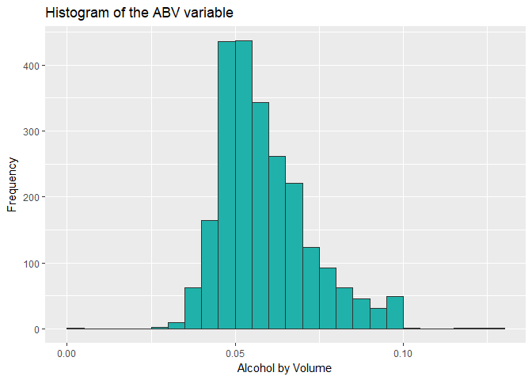
Summary Statistics of the ABV variable
Min. 1st Qu. Median Mean 3rd Qu. Max. Std. Dev NA’s
0.00100 0.05000 0.05600 0.05977 0.06700 0.12800 0.0135 62
Presented to the Brewers Association | Boulder, CO

Slide 8
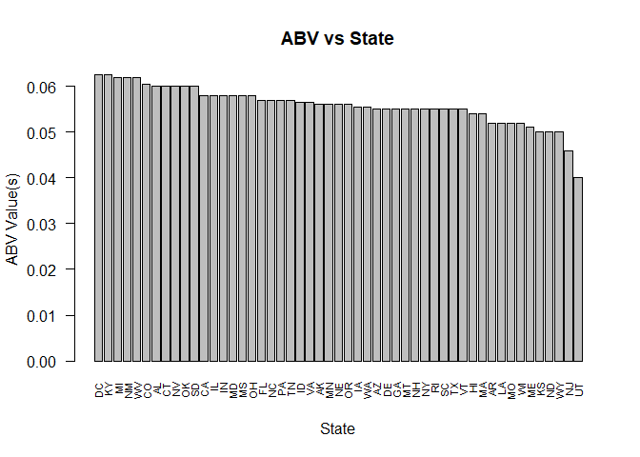
Median alcohol content for beers produced in each State
Presented to the Brewers Association | Boulder, CO

Slide 9
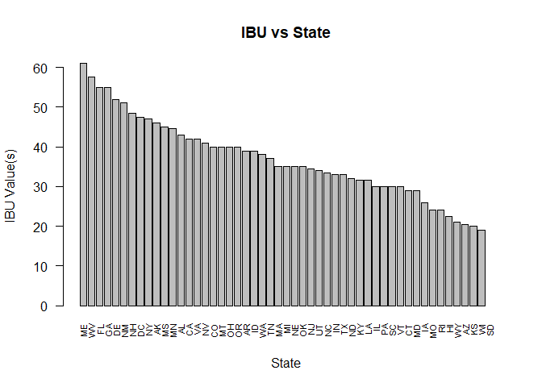
Median Bitterness Units for beers produced in each State
Presented to the Brewers Association | Boulder, CO

Slide 10
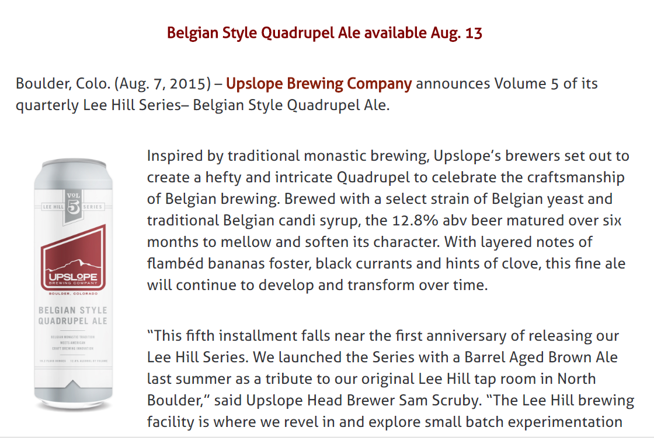
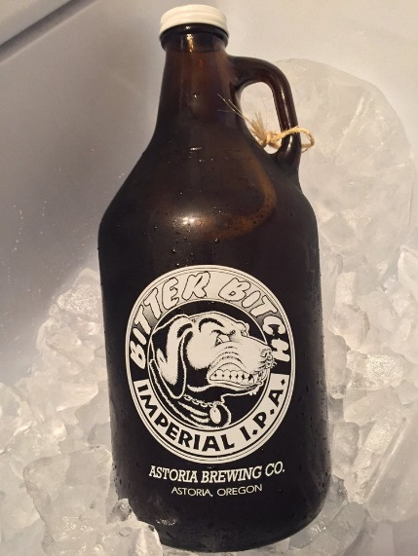
Maximum alcoholic content and maximum bitterness
The State that has maximum alcoholic beer is Colorado, and it’s the “Lee Hill Series Vol. 5”, a Quadrupel Ale with 0.128 ABV
The State that has most bitter (IBU) beer is Oregon, and it’s the “Bitter Bitch”, an Imperial IPA with 138 IBU, produced by Astoria Brewing Co.
Presented to the Brewers Association | Boulder, CO

Slide 11
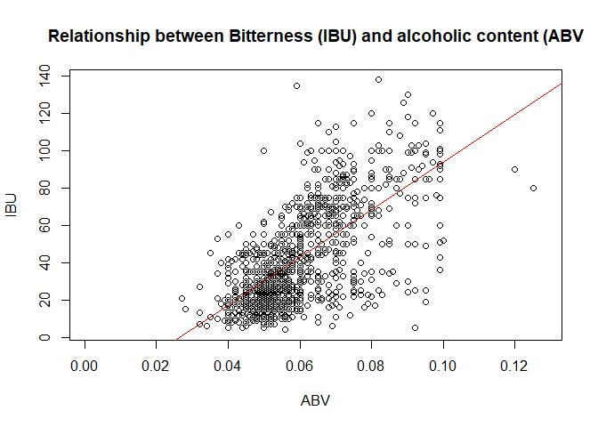
Relationship between Bitterness and alcoholic content
There is a noticeable positive relationship between bitterness and alcoholic content. The correlation coefficient between the variables is 0.67
Presented to the Brewers Association | Boulder, CO

Slide 12
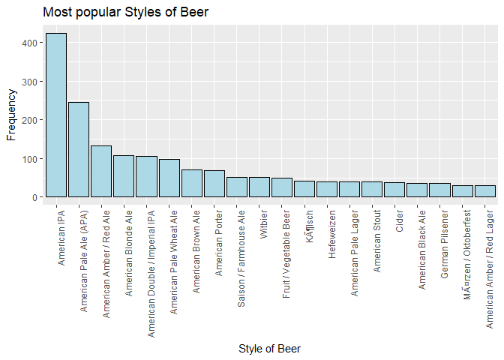
Additional analysis: Most popular beer styles
Presented to the Brewers Association | Boulder, CO

Slide 13
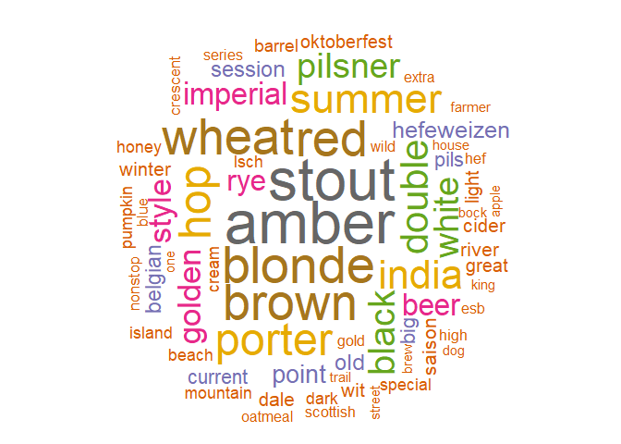
Additional analysis: Common words in beer names
Presented to the Brewers Association | Boulder, CO

Slide 14
Conclusions
Based on the analysis, California and Colorado are the top two States. When we order all the data by Brewery and Beer IDs, . The first six observations include beer names: Parapet ESB, Stronghold, Pumpion, Wall’s End, Maggie’s Leap and Get Together. The last 6 observations include beer names: Pilsner Ukiah, Porkslap Pale Ale, Moo Thunder Stout, Snapperhead IPA, Heinnieweisse Weissebier and Urban Wilderness Pale Ale; Out of 2410 total rows of the data, there are two columns having NA’s: ABV has 62 and IBU has 1005.
After computing the median alcohol content and international bitterness unit for each state. DC has the highest median ABV, MS has the highest median IBV; UT has the lowest median ABV, SD has the lowest median IBV. The State of Colorado has the maximum alcoholic (ABV) beer and Oregon has the most bitter(IBU) beer. After running the summary statistics to ABV variable, the min ABV is 0.001 and the max ABV is 0.128. The Mean is 0.05977 and the median is 0.056. It has a little bit skewness here. Based on the scatter plot, we can see that there is a noticeable positive, linear relationship between the bitterness of the beer and the alcoholic content.
Presented to the Brewers Association | Boulder, CO

